Slide 1


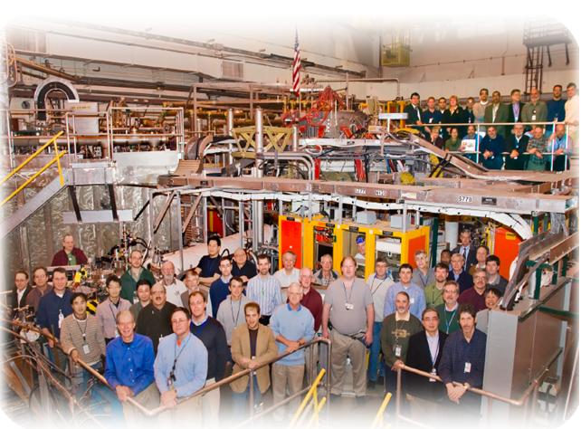

NSTX
Supported by
Development of Improved Vertical Position Control
College W&M
Colorado Sch Mines
Columbia U
CompX
General Atomics
INL
Johns Hopkins U
LANL
LLNL
Lodestar
MIT
Nova Photonics
New York U
Old Dominion U
ORNL
PPPL
PSI
Princeton U
Purdue U
SNL
Think Tank, Inc.
UC Davis
UC Irvine
UCLA
UCSD
U Colorado
U Illinois
U Maryland
U Rochester
U Washington
U Wisconsin
S.P. Gerhardt, E. Kolemen
Culham Sci Ctr
U St. Andrews
York U
Chubu U
Fukui U
Hiroshima U
Hyogo U
Kyoto U
Kyushu U
Kyushu Tokai U
NIFS
Niigata U
U Tokyo
JAEA
Hebrew U
Ioffe Inst
RRC Kurchatov Inst
TRINITI
KBSI
KAIST
POSTECH
ASIPP
ENEA, Frascati
CEA, Cadarache
IPP, Jülich
IPP, Garching
ASCR, Czech Rep
U Quebec
ASC Session, NSTX 2011/12 Research Forum
Location
Date

Slide 2
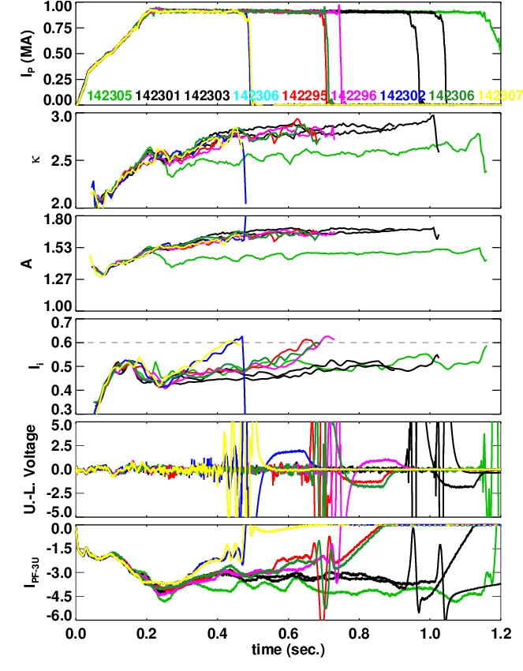
XP in 2010 Showed that Vertical Position Control can be Lost at Higher Aspect Ratio
1 Fiducial (green) and 8 shots at higher aspect ratio.
  Black cases vertically stable, the colored ones have VDEs.
VDE is always triggered when l_{i}=0.6.
  This is not a particularly high value.
  Would preclude use of the scenario for many XPs.
  Many upgrade scenarios with central NBCD have l_{i}>0.6
Motivates improvements to the n=0 controller.

Slide 3
Strategy To Fix Problem
Improve the detection of small vertical motion.
  “dZ/dt Observer”
Re-optimize vertical control gains with improved observer.
If necessary, use RWM coils for vertical control.

Slide 4
Vertical Position Controller is a PD Controller Using Loop Voltages for dZ/dt Measurement
Proportional controller is simply the Isoflux shape control algorithm:
Fast derivative controller is based on the up-down loop voltage difference.
The underlying assumption is that the plasma vertical position can be measured by only 2 loops:
Thesis: Using more loops will lead to a better estimation of the plasma position.
  Eliminate n=1 pickup from random loop orientation problems.
  More information for shapes that are distorted.

Slide 5
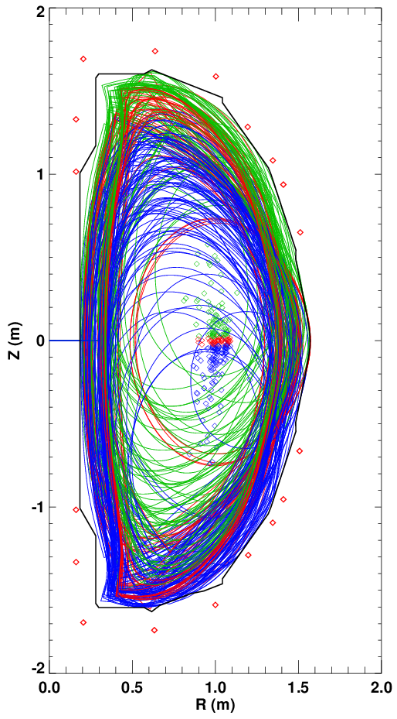
Numerical Tests Have Found That More
Loops Are Better (I)
Constructed ~220 NSTX equilibria.
  Shift them off the axis, change the divertor coils, change I_{P}.
Computed the flux at the various flux loop locations.
Fit the magnetic axis location to a function:

Slide 6
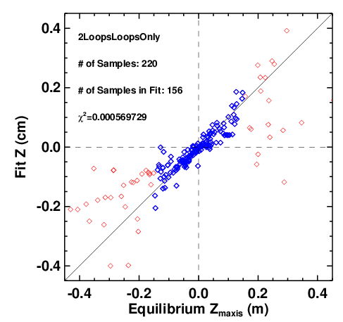
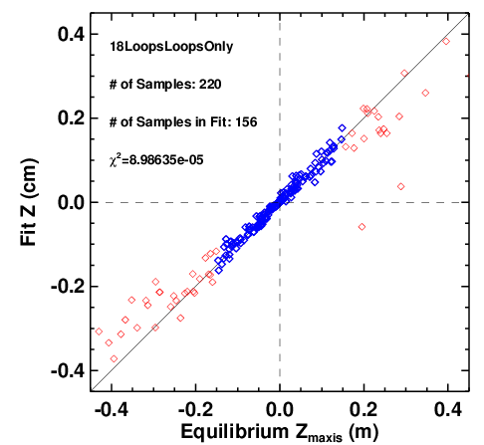
Numerical Tests Have Found That More
Loops Are Better (II)
Use only blue points in the fits (|Z_{maxis}|<15 cm)
1 Pair of Loops
(On Primary Passive Plates)
9 Pair of Loops
(6 Cat. 4, 3 Cat. 3)

Slide 7
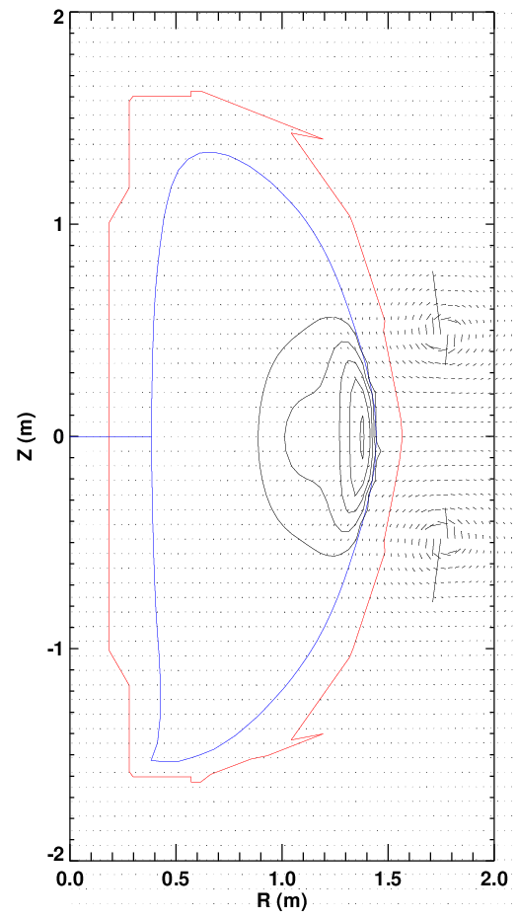
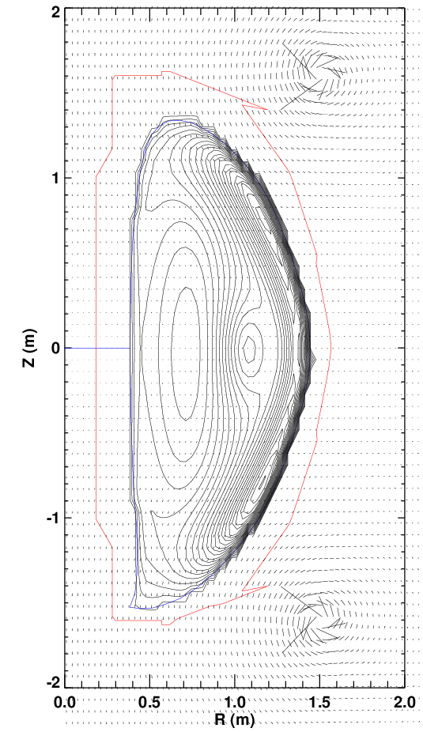
Vertical Position Control May Be Possible With the RWM Coils
Calculate force assuming 1 amp of power supply currents
RWM Coils: F_{Z}=78
PF-3 Coil: F_{Z}=1500
RWM Coils make far less force for the same power supply current.
(ratio is not as bad for lower-elongation plasmas)
However….
1) SPA are very fast (to 3 kA in 1-2 msec)
2) RWM coil field may not couple as strongly to the passive plates.
Use this as a last resort if we have insufficient vertical control margin after other things are tried.

Slide 8
Run Plan
Debugging: Compare PCS calculations to identical off-line versions.
XMP (?): Test that system is correctly coupled to the PF-3 coils.
Day 1: Optimize gains with PF-3 as actuator, new dZ/dt observer.
  Reload vertically unstable target, A~1.75, κ=2.9
  Use divertor gas injection to drive l_{i} up ?
Day 2 (if necessary):
  Repeat unstable scenario, using RWM coils for n=0 control. Do a derivative gain scan.
What if this does not work?
Could replace the PD controller with something more sophisticated.
More voltage capability on PF-3.
Make PF-2 bi-polar for vertical control.
  Or always run with a PF-2 positive bias (not-desirable!)

Slide 9
Backup

Slide 10
PCS Status
dZ/dt Observer
  Complete specification has been written.
  Electronics for voltage difference amplifiers have been ordered.
  Requested they be ready for the ISTP.
  Have not started coding it in PCS.
RWM coils for Z_{axis} control.
  Specification has been written.
    Will be part of the RWM proportional control algorithm.
  Relies on the improved dZ/dt observer for the measurement.
  Have not started on the PCS code yet.

